Slide 1
14th Annual Meeting Bear Lake Association May 29, 2023, 10:00 AM
Notes:
Welcome
Thank you for attending
I hope everyone and their families are healthy
Introduce officers
Thank barb

Slide 2
New Members
Welcome and please introduce yourselves

Slide 3
Agenda
Welcome
Introductions
Health of Bear Lake
2022 PLM Survey Results & Notes
2022 Au Sable Institute Results
2022 CLMP Results – Craig O’Brien
Board of Directors Terms & Members Voting
Jeff Shull has completed his term
Treasurer's Report
Association Account
SAD Account
Related Information
Invasive Species
Water levels
Fish Stocking
Other / Q & A / Discussion
Loon Report – Mary, Our Loon Ranger
What You Can Do

Slide 4
2022 PLM Survey Results
In 2022, 0.75 acres of EWM @ $2000
In 2021, 8.3 acres of EWM @ $5600
In 2020, 3.4 acres of EWM @ $3100
Algae treated all years

Slide 5
2022 PLM Survey Notes
“2022 was a great year on Bear Lake!”
“The 2021 treatment season proved extremely effective... we utilized a newer technology to treat EWM in September.”
“Systemic control, attacking the root system, can vary lake to lake and plant to plant, but the goal is to knock back those roots and provide longer control and potentially carry over into the next season(s).”

Slide 6
2022 PLM Survey Notes
“We expect to treat more EWM than 2022 (always prepared for worse case), but overall, the Bear Lake program has been so effective, it is a testimony to proactive EWM management in the state.”
The warmer than usual winter, combined with climate change and evolving plant genetics is proving to have more weed growth already this year, both native and nonnative, in many lakes.

Slide 7
2022 AuSable Institute Survey
“Bear Lake is doing well, but it would definitely enhance the long-term health of the lake (and property values!) if the ‘green belt’ around the lake was protected or planted. Some areas of the lake need indigenous (native to Michigan) vegetation planted and protected.”

Slide 8
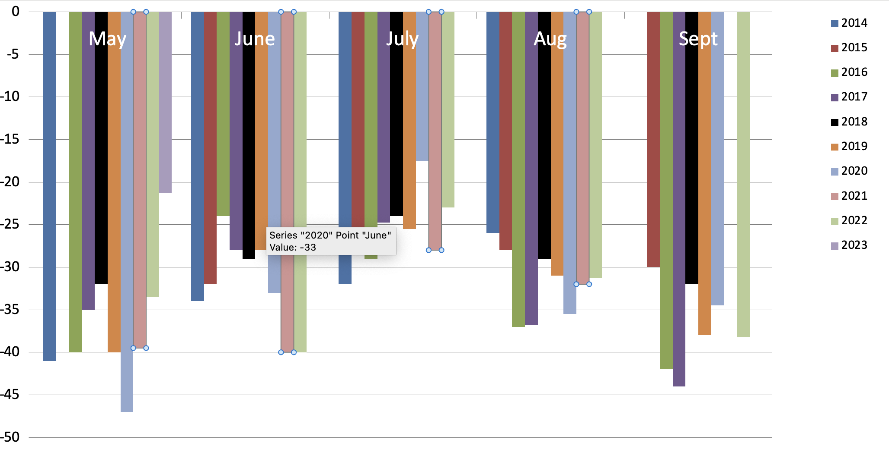
2022 CLMP Secchi (Clarity) Readings

Slide 9
2022 CMLP Results – TSI Numerical Scale Indicating Nutrient Enrichment
Oligotrophic <36 Meso/Eutro 46-50
Oligo/Meo 36-40 Eutrophic 51-61
Mesotrophic 41-45 Hypereutrophic >61
TSI for Bear Lake in 2021
Average | 31
Secchi Disk | 26
Summer TP | 30
Chlorophyll-a | 36

Slide 10
2022 CMLP Results – TSI Numerical Scale Indicating Nutrient Enrichment
Average TSI 2022 2017-2021 1975-2016
Bear Lake 31 28 30
All CMP Lakes 44 40 43
With an average TSI score of 31 based on 2022 Secchi transparency, chlorophyll-a, and summer total phosphorus data, this lake is rated as an oligotrophic lake.

Slide 11
2022 CLMP Results
Oligotrophic: Generally deep and clear lakes with little aquatic plant or algae growth. These lakes maintain sufficient dissolved oxygen in the cool, deep-bottom waters during late summer to support cold water fish, such as trout and whitefish.

Slide 12
Board of Directors Terms & Voting
Jeff’s 3-year term is completed.
Approval of new directors requires a 2/3 majority vote from active members attending this meeting.

Slide 13
Treasurer's Report
Special Assessment District Account
This year’s fee based on previous year’s expenses and this year’s estimated expenses - $22.00
Lake treatment expenses average about $4,700 per year
Administrative expenses average about $1,200 per year
Current balance – $8,009.75
Lake Association Account
$1,911.69 + $.00 (donations) - $8.98 (expenses) = $1,902.71

Slide 14
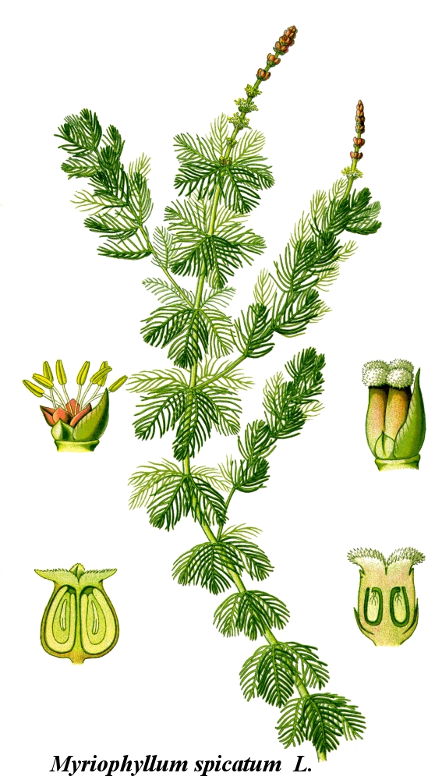
Eurasian Water Milfoil

Slide 15
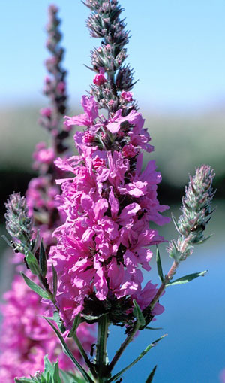
Purple Loosestrife

Slide 16
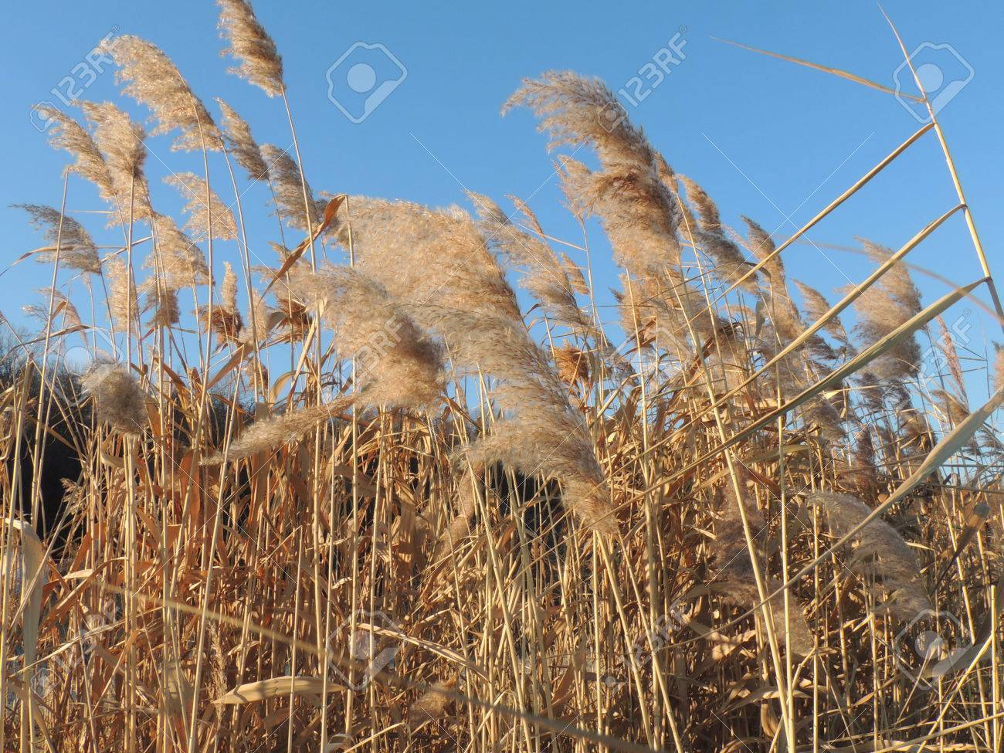
Phragmites

Slide 17
Lake Water Levels – Historical

Slide 18
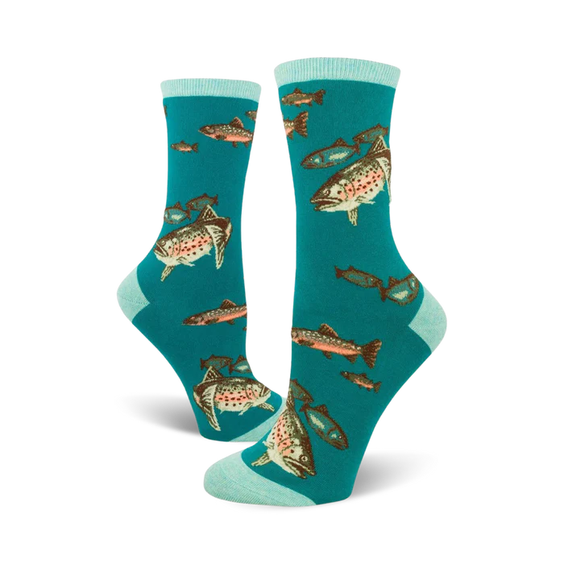
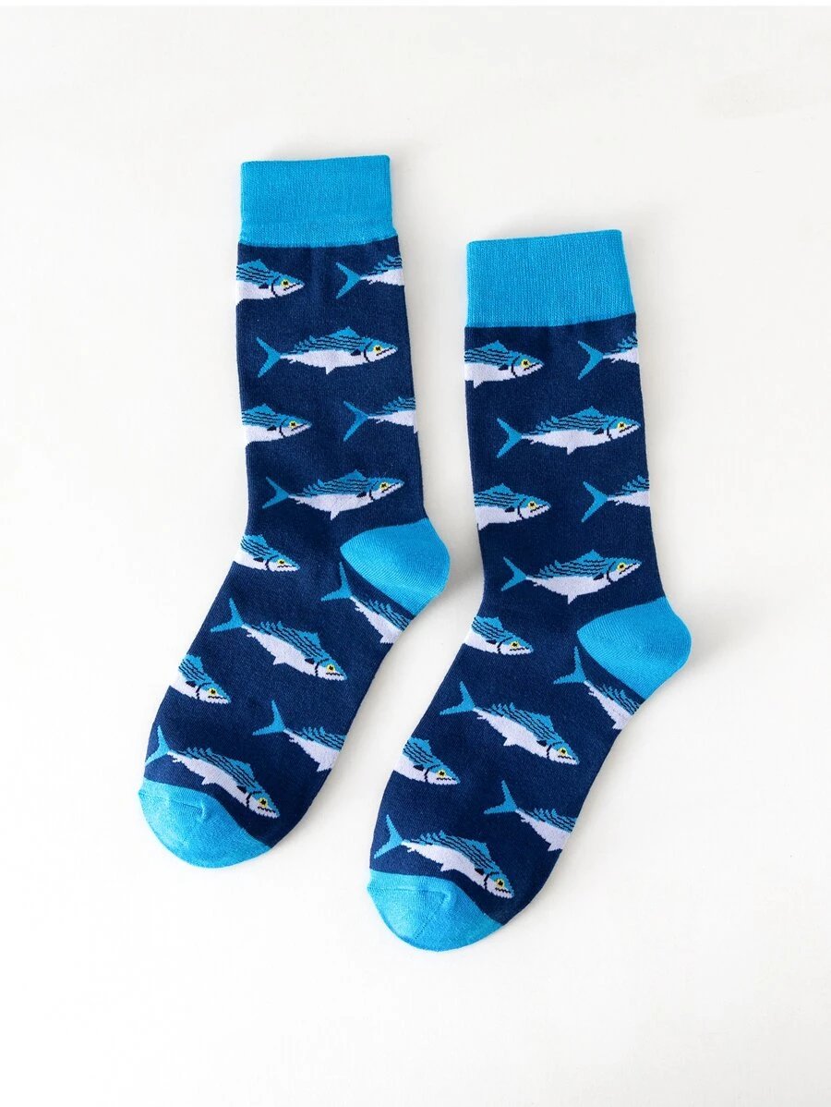
Fish Stockings
Added April 18, 2023
4,800 rainbow trout averaging 7.8”
14,215 brown trout averaging 7.05”

Slide 19
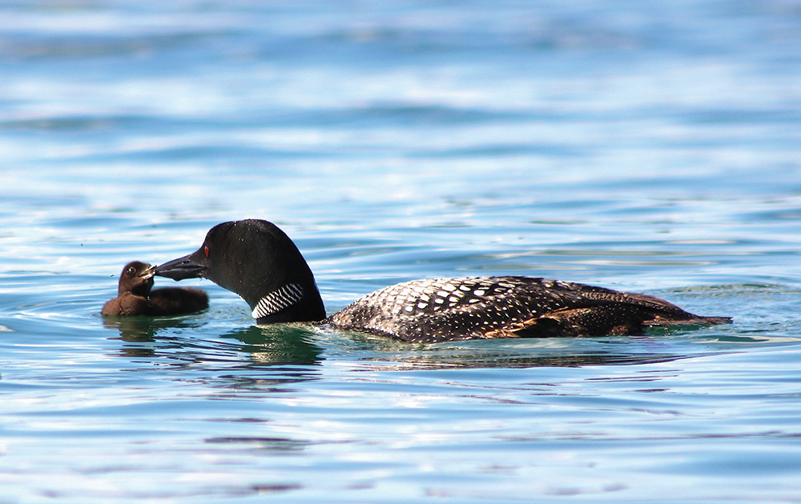
Loon Report – Mary, The Loon Ranger
From Bear Lake Photojournalist, Kim Schneider
https://www.mibluemag.com/postcard-1/loon-love/

Slide 20
What You Can Do
Stay committed to a healthy lake
RAKE-THE-LAKE
Naturalize your shorelines
Clean boats & trailers before launching – it’s the law
Check your septic system & keep them functioning well
High speed/wake boating only from 11 am – 7:30 pm
Wave energy causes erosion and nutrient dump. We advise travel more than 300’ from end of docks/rafts.
Do not feed the ducks
Protect our loons

Slide 21
Adjourn
Q & A: email – bearlakekalkaska@gmail.com
Community Cards
Minutes, presentation and 2022 CLMP Report to be posted on website – bearlakeassoc.com
Sign-up for automatic email notes
Quick Reminders:

