Slide 1
15th Annual Meeting
Bear Lake Association
May 27, 2024, 9:00 AM
Notes:
Welcome
Thank you for attending
I hope everyone and their families are healthy
Introduce officers
Thank barb

Slide 2
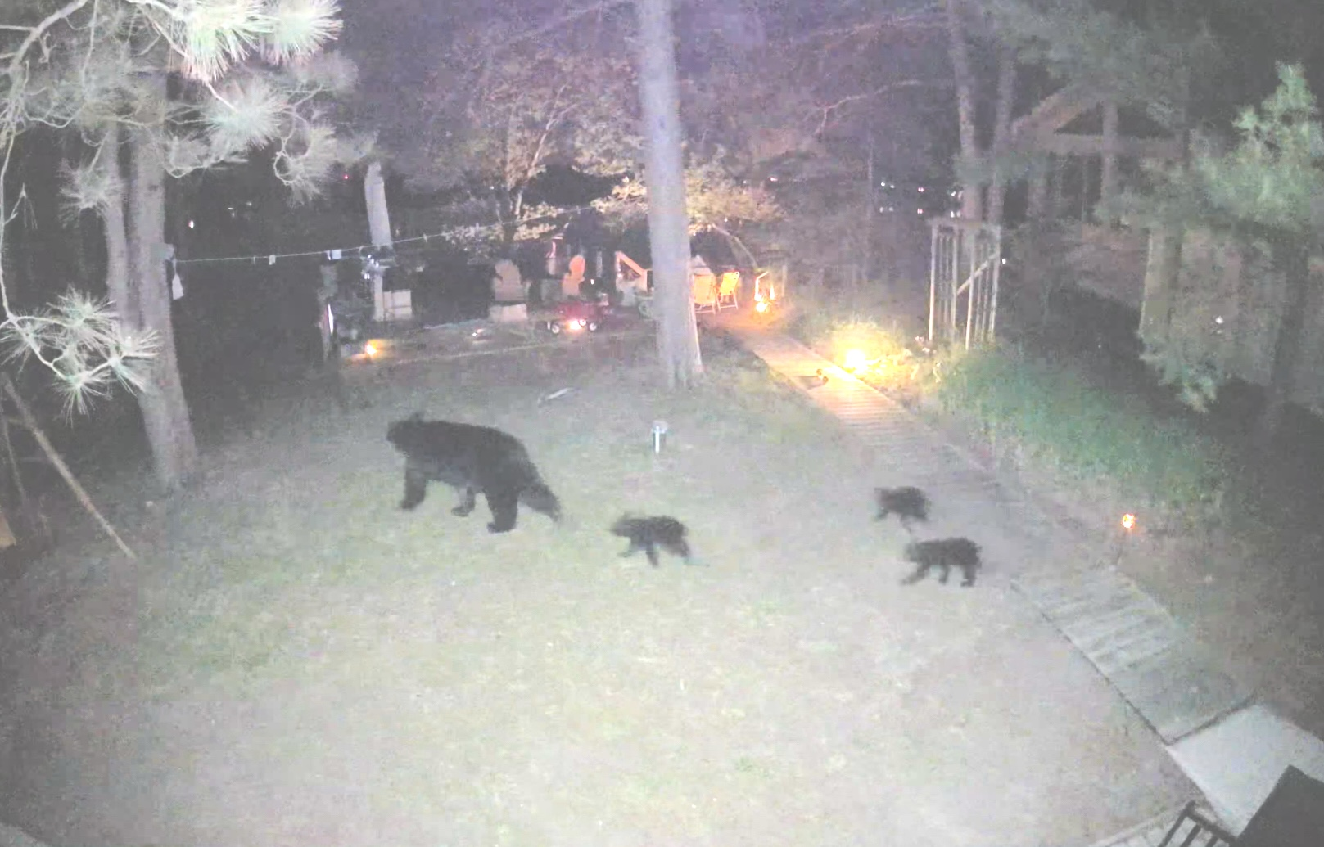
Bear Lake Visitors

Slide 3
New Members
Welcome and please introduce yourselves

Slide 4
Agenda
Welcome
Introductions
Health of Bear Lake
2023 PLM Survey Results & Notes
2023 Au Sable Institute Results
2023 CLMP Results – Craig O’Brien
Board of Directors Terms & Members Voting
Sam & Brian’s terms are completed
Treasurer's Report
Association Account, SAD Account
Related Information
Invasive Species
Water levels
Fish Stocking
Loon Report – Mary, Our Loon Ranger
Other / Q & A / Discussion
What You Can Do

Slide 5
2023 PLM Survey Results
In 2023, 4.5 acres of EWM @ ~$3600
In 2022, 0.75 acres of EWM @ ~$2000
In 2021, 8.3 acres of EWM @ ~$5600
Algae treated all years

Slide 6
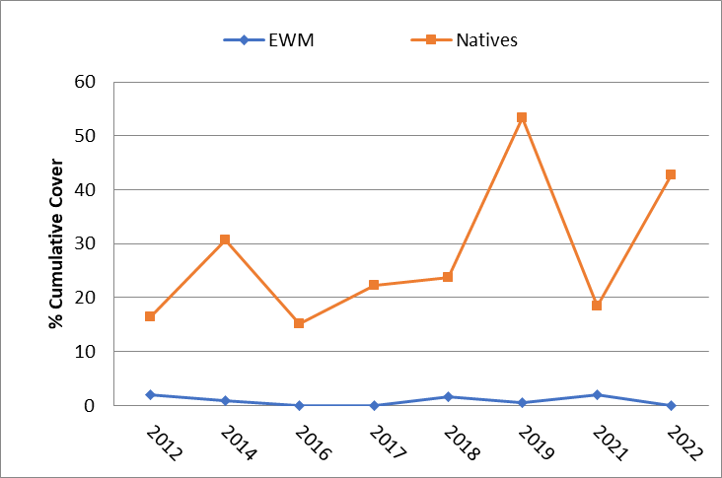
2023 PLM Survey Notes

Slide 7
2023 PLM Survey Notes
Bear Lake has a minor infestation of the nonnative, invasive plant, Eurasian water-milfoil (EWM). This species can crowd out native plant communities and negatively impact the ecological health of the lake, as well as recreational uses and aesthetical values of the waterbody.
Native and non-native milfoils can hybridize causing populations that require increased application rates and more aggressive treatment protocols.

Slide 8
2023 AuSable Institute Survey
“Based on our sampling and analysis of the data, we can say that Bear Lake is a healthy oligotrophic lake. The amount of dissolved oxygen throughout the lake, which is one of the most important qualities in assessing water quality, indicates that there is sufficient oxygen to sustain aquatic life and activity. The Secchi disk depth and Trophic State Index indicate that there is a healthy balance between nutrient levels and algal biomass within the lake…and little to no blue-green algae, which is excellent. After analyzing the different bacteria samples taken around Bear Lake, we did not find any signs of fecal coliform bacteria, indicating that Bear Lake is extremely clean. Our data analysis does not show any concerns or issues about the lake, which indicates that the local homeowners are practicing good management strategies.”

Slide 9
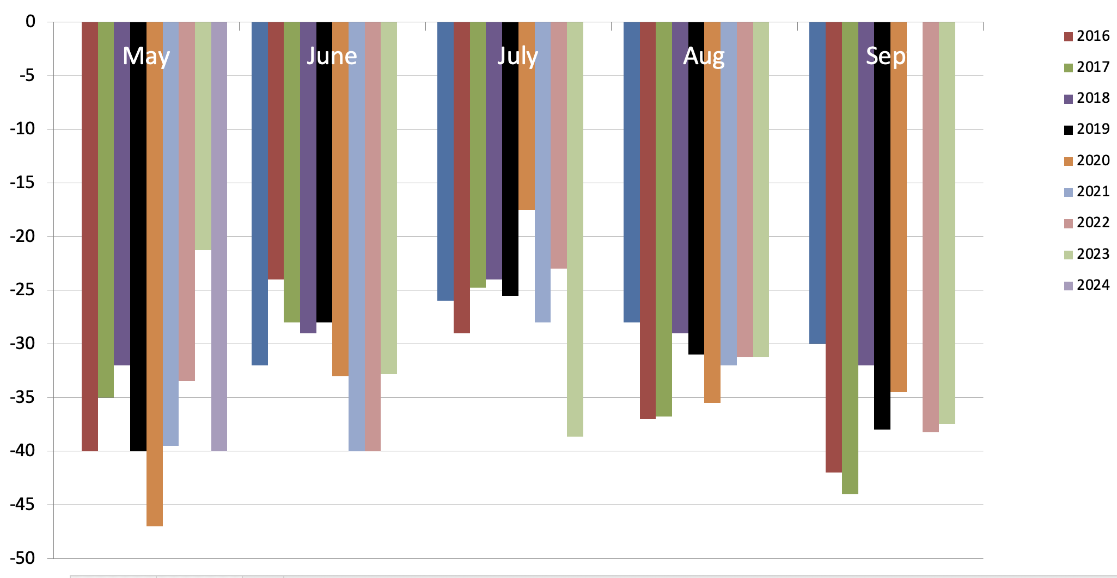
2023 CLMP Secchi (Clarity) Readings

Slide 10

2023 CMLP Results – TSI
Numerical Scale Indicating Nutrient Enrichment
Oligotrophic <36 Meso/Eutro 46-50
Oligo/Meo 36-40 Eutrophic 51-61
Mesotrophic 41-45 Hypereutrophic >61
TSI for Bear Lake in 2023
Average | 30
Secchi Disk | 27
Summer TP | 27
Chlorophyll-a | 35

Slide 11
2023 CMLP Results – TSI
Numerical Scale Indicating Nutrient Enrichment
Average TSI 2023 2018-2022 1975-2017
Bear Lake 30 29 29
All CMLP Lakes 44 41 42
With an average TSI score of 30 based on 2023 Secchi transparency, chlorophyll-a, and summer total phosphorus data, this lake is rated as an oligotrophic lake.

Slide 12
2023 CLMP Results
Oligotrophic: Generally deep and clear lakes with little aquatic plant or algae growth. These lakes maintain sufficient dissolved oxygen in the cool, deep-bottom waters during late summer to support cold water fish, such as trout and whitefish.

Slide 13
Board of Directors Terms & Voting
Sam & Brian’s 3-year term is completed.
Approval of new directors requires a 2/3 majority vote from active members attending this meeting.

Slide 14
Treasurer's Report
Special Assessment District Account
This year’s fee is based on previous year’s expenses and this year’s estimated expenses - $32.00
Lake treatment expenses average about $4,500 per year (12 years)
Administrative expenses average about $1,200 per year (6 years)
Current balance – $8111.52
Lake Association Account
$1,902.71 beginning balance
+ $200.00 (donations)
+ $288.79 (shirt sales)
- ($52.22) (expenses *)
= $2,339.28 ending balance
* refreshments, stamps, copies

Slide 15
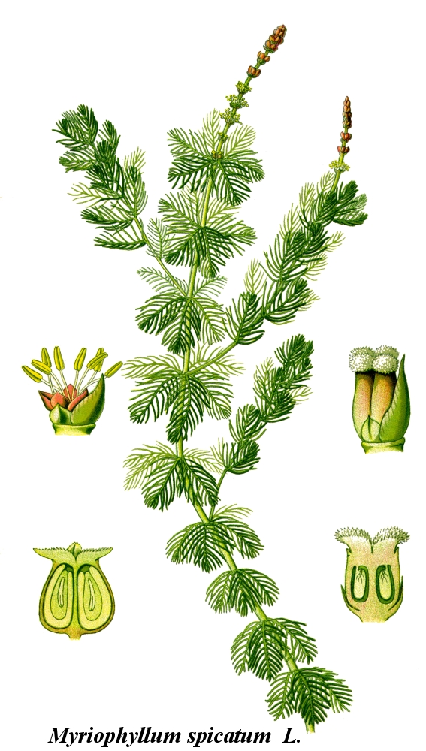
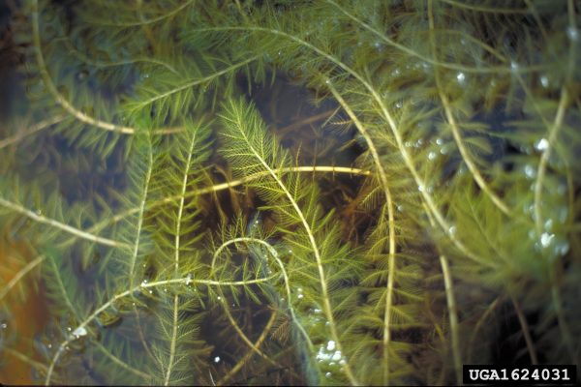
Eurasian Water Milfoil

Slide 16
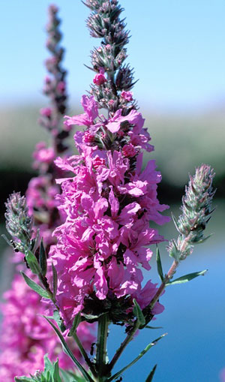
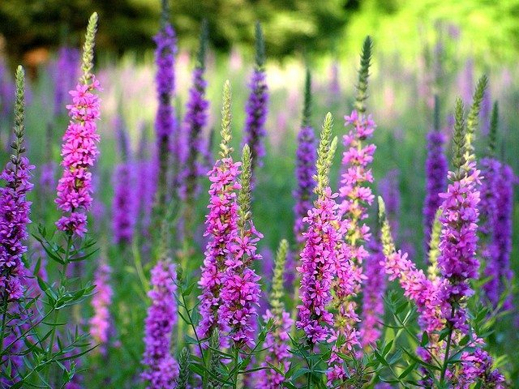
Purple Loosestrife

Slide 17
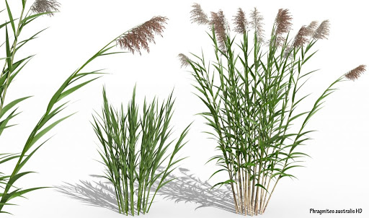
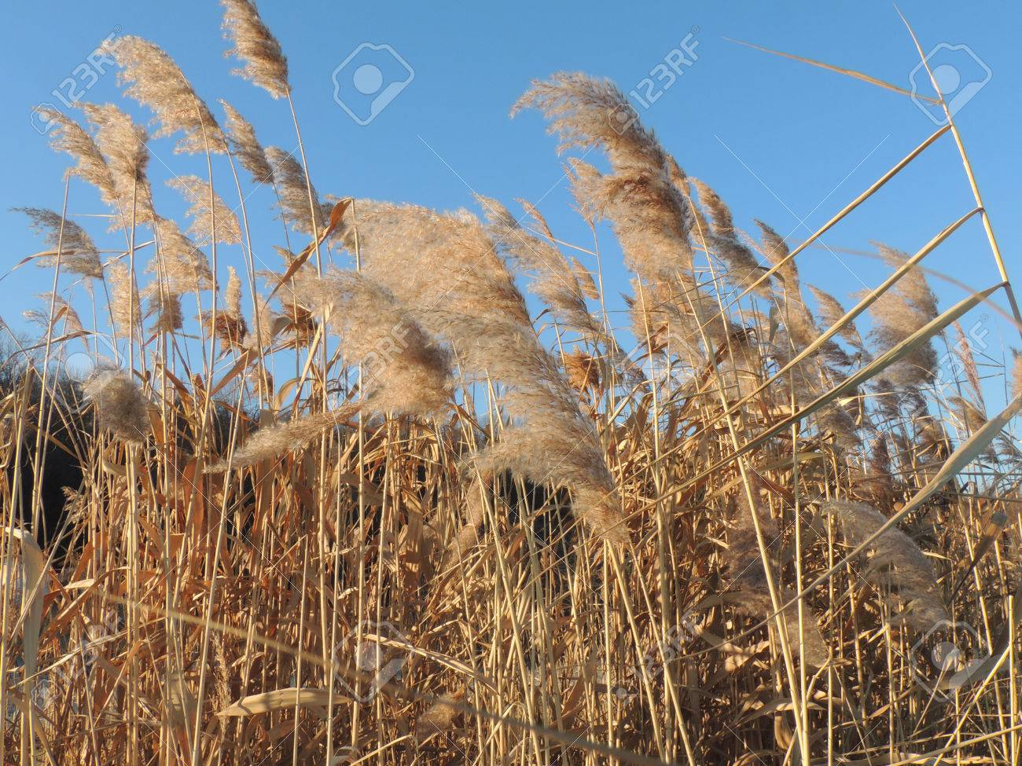
Phragmites

Slide 18
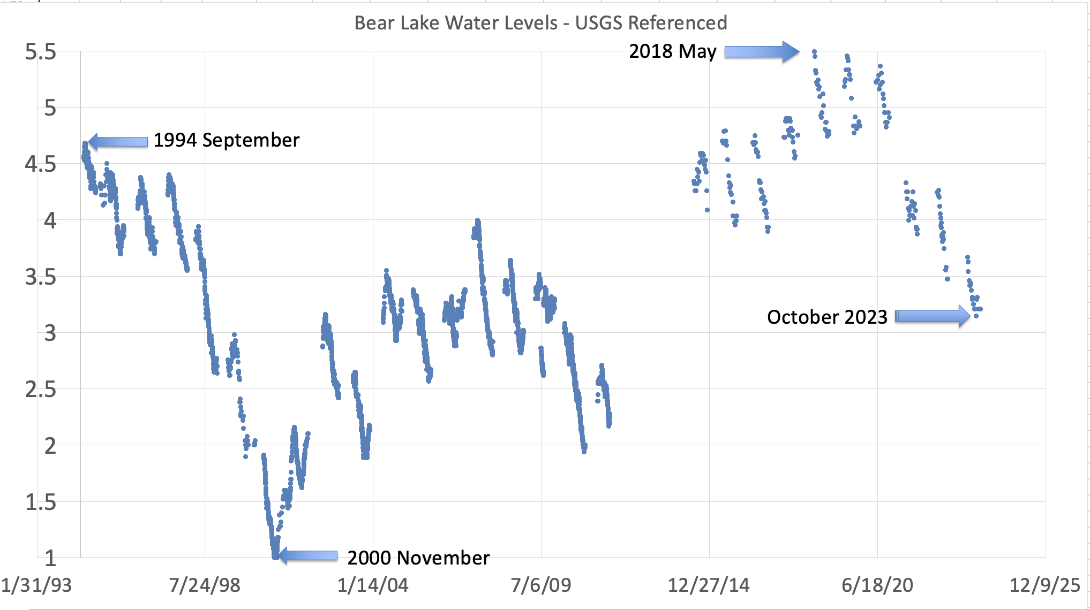
Lake Water Levels – Historical

Slide 19
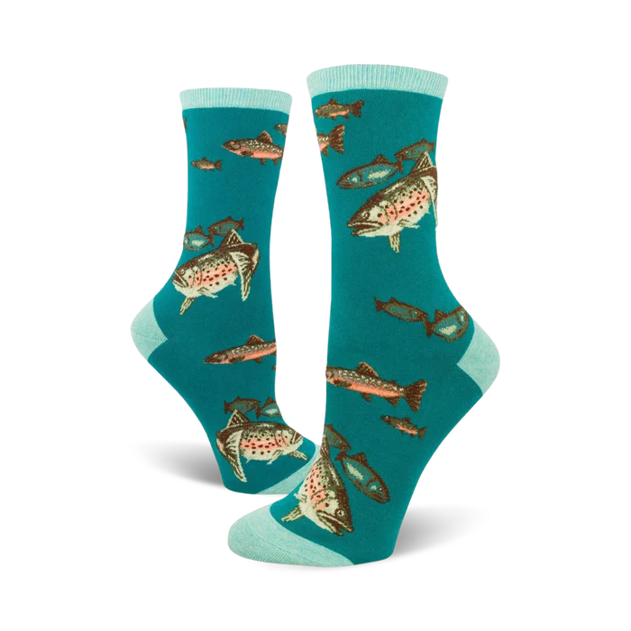
Fish
Stockings
  Added March 3, 2024 & April 2, 2024
    5,495 rainbow trout averaging 7.70”
    14,700 brown trout averaging 6.96”

Slide 20
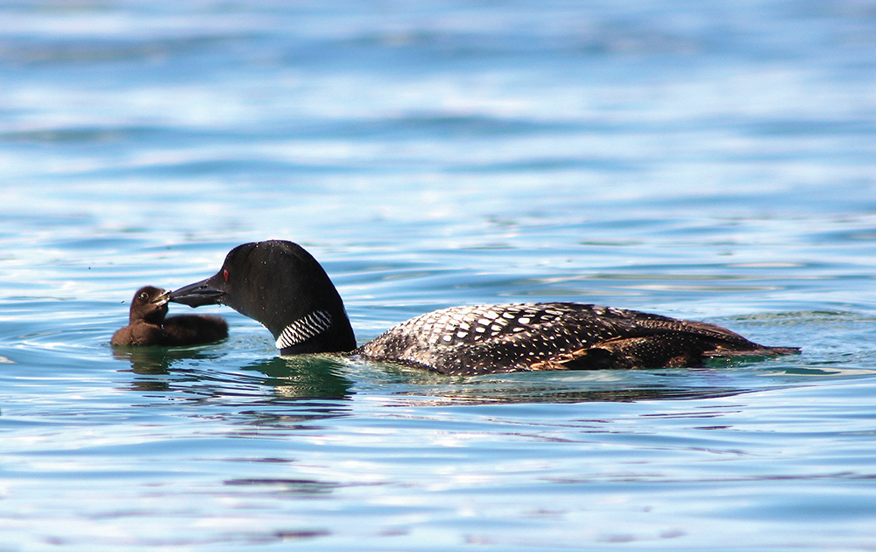
Loon Report – Mary, The Loon Ranger
From Bear Lake Photojournalist, Kim Schneider
https://www.mibluemag.com/postcard-1/loon-love/

Slide 21
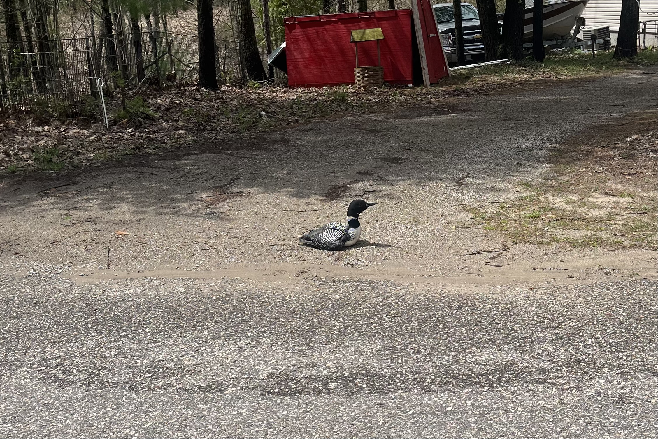
Like a Duck Loon Out of Water

Slide 22
What You Can Do
Stay committed to a healthy lake
RAKE-THE-LAKE. Decomposing leaves produces muck.
Naturalize your shorelines
Clean boats & trailers before launching – it’s the law
Check your septic system & keep them functioning well
High speed/wake boating only from 11 am – 7:30 pm
Wave energy causes erosion and nutrient dump. We advise travel more than 300’ from end of docks/rafts.
Do not feed the ducks or geese
Protect our loons

Slide 23



Adjourn
Q & A: email bearlakekalkaska@gmail.com
Minutes, presentation, PLM, CLMP, AuSable Reports on website bearlakeassoc.com
Sign-up for automatic email notes
Check out the Resources and Videos tabs

