Slide 1
16th Annual Meeting Bear Lake Association May 25, 2025, 4:00 PM
Notes:
Welcome
Thank you for attending
I hope everyone and their families are healthy
Introduce officers
Thank barb

Slide 3
Meeting Decorum
Robert Rules of Order
Raise your hand to speak
One speaker at a time for 2 minutes
Motion, 2nd, discussion, vote
Only owners whose property abuts the lake may vote – one vote per parcel

Slide 4
Agenda
Welcome & Introductions
Board Attendance
Administrative
Agenda Review & Approval
2024 Meeting Minutes Review & Membership Voting
Treasurer’s Report Review & Membership Voting
SAD Account Review
Board of Directors Terms & Membership Voting
Health of Bear Lake
2024 PLM Survey Results & Treatment
2024 CLMP Results
Related Lake Information
Invasive species
Water Levels
Fish Stocking
Informational Videos
Loon Report – Mary, Our Loon Ranger
Eleanor Bay Dredging – Membership Discussion
What You Can Do

Slide 5
Treasurer's Report
$2,339.28 beginning balance
+ $25.00 (donation)
- ($59.86) (expenses *)
$2304.42 ending balance
* stamps & copies

Slide 6
Special Assessment District Account
PLM estimated expenses PLUS
Estimates administrative expenses MINUS
Last year’s balance DIVIDED BY
157 parcels EQUALS
$29 2025 SAD fee
Lake treatment expenses average about $4,500 per year (13 years)
Administrative expenses average about $1,400 per year (8 years)
Current balance – $8175.72

Slide 7
Board of Directors Terms & Voting
Cheryl & John’s 3-year term is completed.
Approval of new directors requires a 2/3 majority vote from active members attending this meeting.

Slide 8
2024 PLM Survey Notes
Bear Lake has a minor infestation of the nonnative, invasive plant, Eurasian water-milfoil (EWM). This species can crowd out native plant communities and negatively impact the ecological health of the lake, as well as recreational uses and aesthetical values of the waterbody.
Native and non-native milfoils can hybridize causing populations that require increased application rates and more aggressive treatment protocols.

Slide 9
2024 PLM Survey Notes

Slide 10
2024 PLM Survey Results
In 2024, 2.5 acres of EWM @ ~$1950
In 2023, 4.5 acres of EWM @ ~$3600
In 2022, 0.75 acres of EWM @ ~$2000
In 2021, 8.3 acres of EWM @ ~$5600

Slide 11
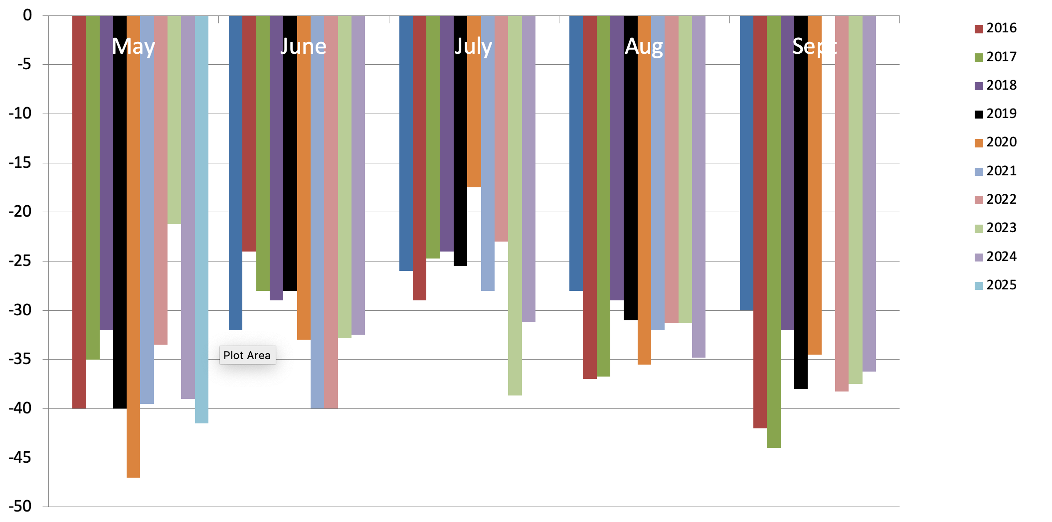
2024 CLMP Secchi (Clarity) Readings

Slide 12
2024 CMLP Results – TSI Numerical Scale Indicating Nutrient Enrichment
Oligotrophic <36 Meso/Eutro 46-50
Oligo/Meo 36-40 Eutrophic 51-61
Mesotrophic 41-45 Hypereutrophic >61
TSI for Bear Lake in 2024
Average | 26
Secchi Disk | 26
Summer TP | 27
Chlorophyll-a | 35

Slide 13
2024 CMLP Results – TSI Numerical Scale Indicating Nutrient Enrichment
Average TSI 2024 2018-2023 1975-2017
Bear Lake 26 30 29
All CMLP Lakes 41 42 42
With an average TSI score of 26 based on 2024 Secchi transparency, chlorophyll-a, and summer total phosphorus data, this lake is rated as an oligotrophic lake.

Slide 14
2024 CLMP Results
Oligotrophic: Generally deep and clear lakes with little aquatic plant or algae growth. These lakes maintain sufficient dissolved oxygen in the cool, deep-bottom waters during late summer to support cold water fish, such as trout and whitefish.

Slide 15
Eurasian Water Milfoil

Slide 16
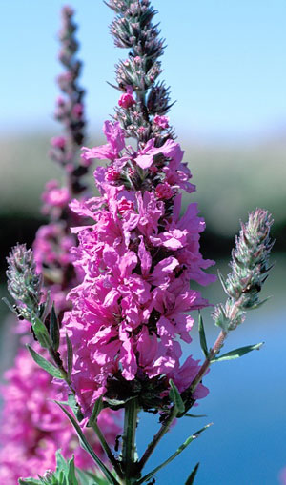
Purple Loosestrife

Slide 17
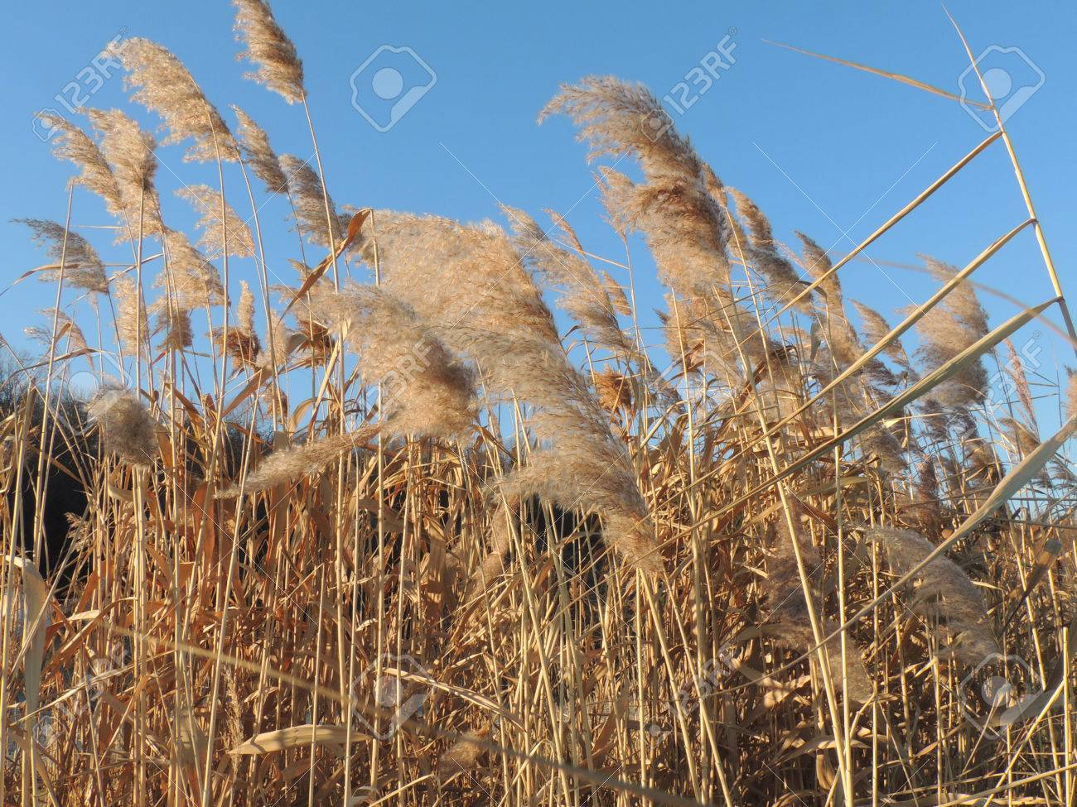
Phragmites

Slide 18
Lake Water Levels – Historical

Slide 19
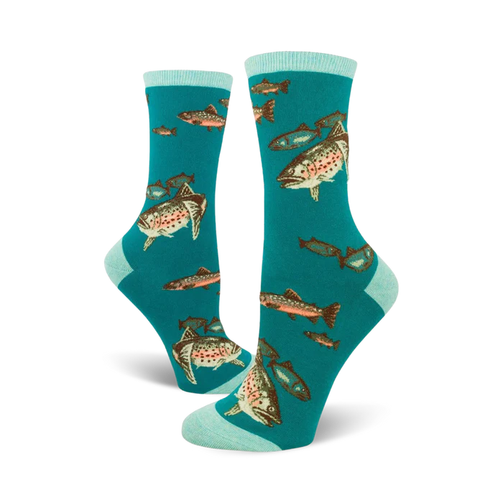
Fish Stockings
Added April 16, 2025
5,200 rainbow trout averaging 7.88”
15,595 brown trout averaging 7.76”

Slide 20
Informational Videos
Rake the Lake
Septic System (coming soon)
Loons (coming soon)

Slide 21
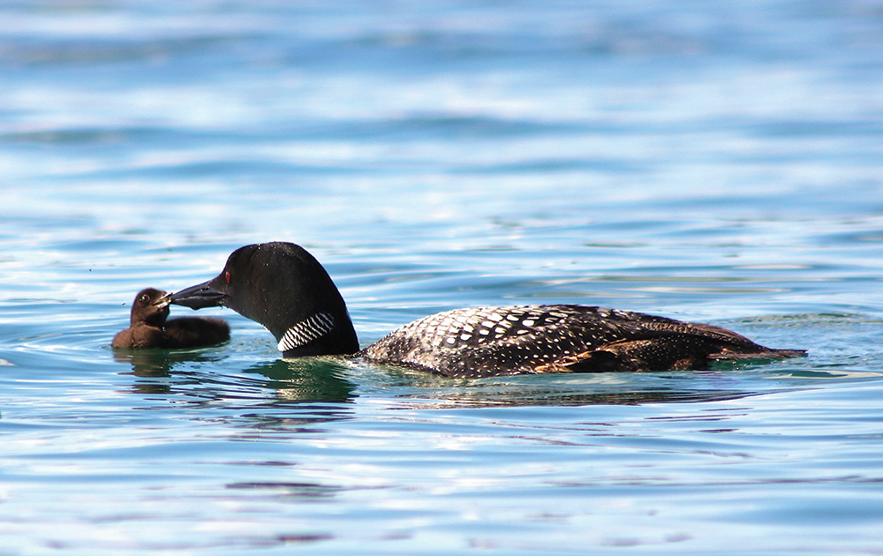
Loon Report – Mary, The Loon Ranger
From Bear Lake Photojournalist, Kim Schneider
https://www.mibluemag.com/postcard-1/loon-love/

Slide 22
Eleanor Bay Dredging
Open Discussion

Slide 23
What You Can Do
Stay committed to a healthy lake
RAKE-THE-LAKE. Decomposing leaves produces muck.
Naturalize your shorelines
Clean boats & trailers before launching – it’s the law
Check your septic system & keep them functioning well
High speed/wake boating only from 11 am – 7:30 pm
Wave energy causes erosion and nutrient dump. We advise travel more than 300’ from end of docks/rafts.
Do not feed the ducks or geese
Protect our loons

Slide 24
Adjourn
Q & A: email bearlakekalkaska@gmail.com
Minutes, presentation, PLM & CLMP on website bearlakeassoc.com
Sign-up for automatic email notes
Check out the Resources and Videos tabs

