Slide 1
17th Annual Meeting
Bear Lake Association
May 24, 2026, 4:00 PM
Notes:
Welcome
Thank you for attending
I hope everyone and their families are healthy
Introduce officers
Thank barb

Slide 2
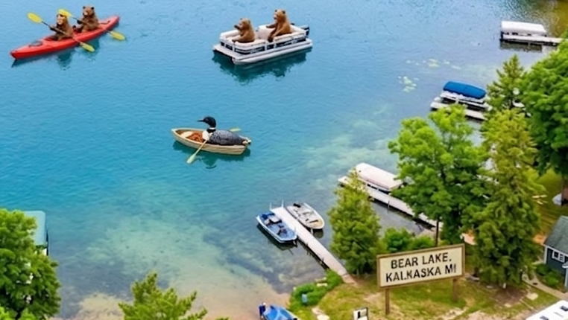

Slide 3
Meeting Decorum
Robert Rules of Order
Raise your hand to speak, introduce yourself
One speaker at a time for 2 minutes
Motion, 2nd, discussion, vote
Only owners whose property abuts the lake may vote – one vote per parcel

Slide 4
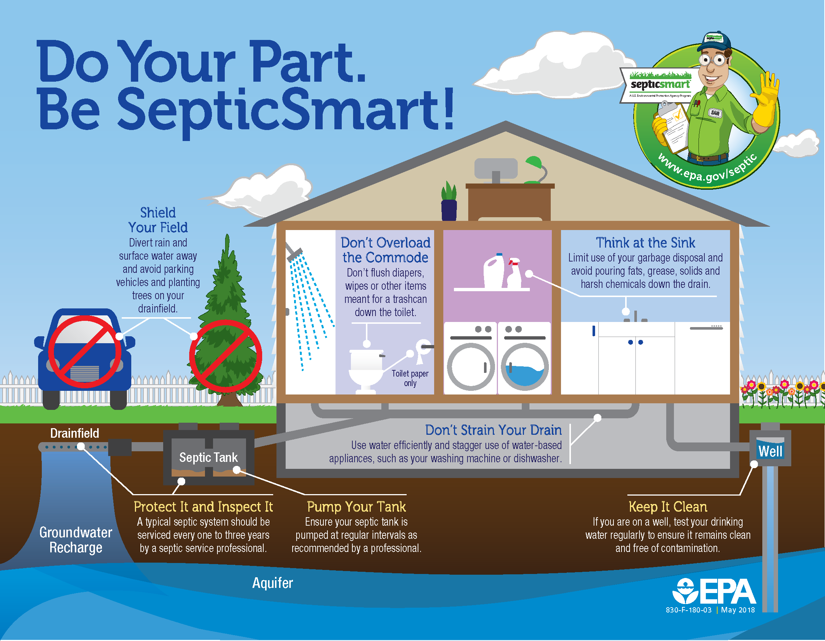
Septic Systems - Wayne Pavlika

Slide 5
Agenda
Pledge of Allegiance
Welcome, Board Attendance & Introductions
Welcome New Members
Meeting Decorum
Septic Systems Care & Maintenance – Wayne Pavlika
Administrative
  Agenda Review & Approval
  2025 Annual Meeting Minutes Review & Approval
  Treasurer’s Report Review & Approval
  SAD Account Review
  Board of Directors Terms & Approval
  By-Laws Amendments Review
Health of Bear Lake
  2025 PLM Survey Results
  2025 CLMP Results – Craig O’Brien
Related Lake Information
  Invasive species
  Water Levels
  Fish Stocking
  Website Review
Loon Report – Mary, Our Loon Ranger
Open Discussion
What You Can Do
Adjourn

Slide 6
Agenda Review & Approval
Welcome & Introductions
Board Attendance & Introductions
Welcome New Members
Septic Systems Care & Maintenance – Wayne Pavlika
Administrative
Health of Bear Lake
Related Lake Information
Loon Report – Mary, Our Loon Ranger
Open Discussion
What You Can Do
Adjourn

Slide 7
  2025 Annual Minutes Review & Approval

Slide 8
Treasurer's Report Review & Approval
$2,304.42 beginning balance
+ $425.00 (donations)
- ($148.86) (expenses *)
$2580.56 ending balance
* stamps & copies

Slide 9
Special Assessment District Account
PLM estimated expenses ($7786.00) PLUS
Estimated administrative expenses ($1500) MINUS
Last year’s balance ($2052.63) DIVIDED BY
157 parcels EQUALS
$46 2026 SAD fee
Lake treatment expenses range between $2100 - $5800 in the last few years.
Administrative expenses range between $1100 - $2000 in the last few years.
Current balance – $8010.63

Slide 10
Board of Directors Terms & Voting
Jeff’s 3-year term is completed.
Approval of new directors requires a 2/3 majority vote from active members attending this meeting.

Slide 11
By-Laws Review
Board member resignations
By-Laws amendments approval
Proxy
Members vs land area SAD approval

Slide 12
2025 PLM Survey Results
Bear Lake has a minor infestation of the nonnative, invasive plant, Eurasian watermilfoil (EWM) and Phragmites.
We have been seeing more mixed beds of Native Milfoil with EWM, during the 2025 season. We will be targeting these beds to reduce the risk of hybridization.
Phragmites has been found in a few areas on the lake, primarily on the west side of the lake.
Continued monitoring and herbicide treatment, when necessary, is recommended to maintain the pristine condition of Bear Lake.

Slide 13
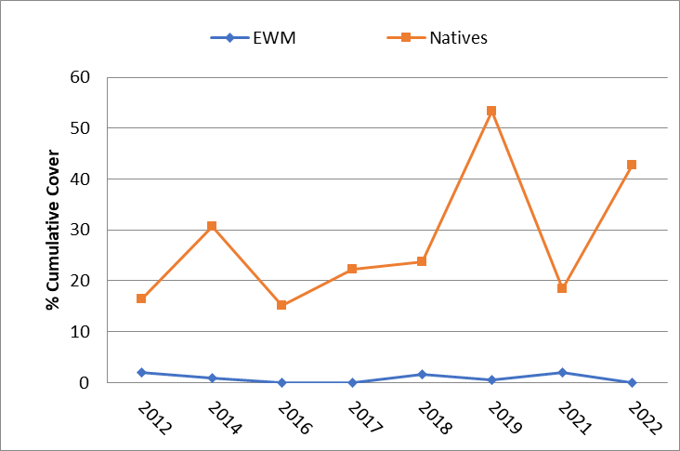
2025 PLM Survey Results

Slide 14
2025 PLM Survey Results
In 2025, 5.0 acres of EWM @ ~$5800
In 2024, 2.5 acres of EWM @ ~$2400
In 2023, 4.5 acres of EWM @ ~$4000
In 2022, 0.75 acres of EWM @ ~$2100

Slide 15
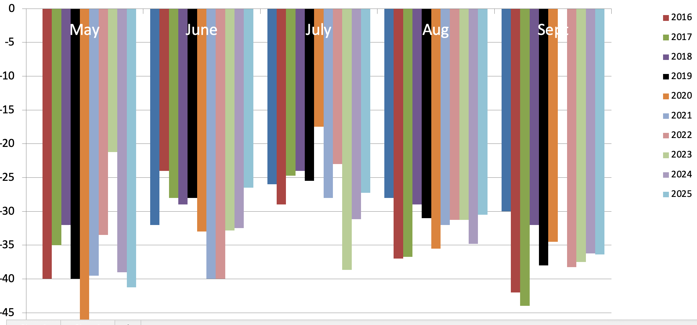
2025 CLMP Secchi (Clarity) Readings

Slide 16

2025 CMLP Results – TSI
Numerical Scale Indicating Nutrient Enrichment
Oligotrophic <36 Meso/Eutro 46-50
Oligo/Meo 36-40 Eutrophic 51-61
Mesotrophic 41-45 Hypereutrophic >61
TSI for Bear Lake in 2025
Average | 30
Secchi Disk | 27
Summer TP | 30
Chlorophyll-a | 34

Slide 17
2025 CMLP Results – TSI
Numerical Scale Indicating Nutrient Enrichment
Average TSI 2025 1975-2024
Bear Lake 30 29
All CMLP Lakes 42 42
With an average TSI score of 30 based on 2025 Secchi transparency, chlorophyll-a, and summer total phosphorus data, this lake is rated as an oligotrophic lake.

Slide 18
2025 CLMP Results
Oligotrophic: Generally deep and clear lakes with little aquatic plant or algae growth. These lakes maintain sufficient dissolved oxygen in the cool, deep-bottom waters during late summer to support cold water fish, such as trout and whitefish.

Slide 19
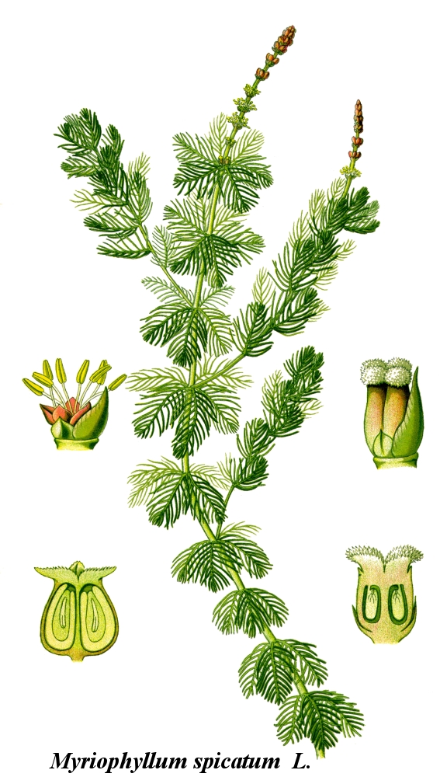
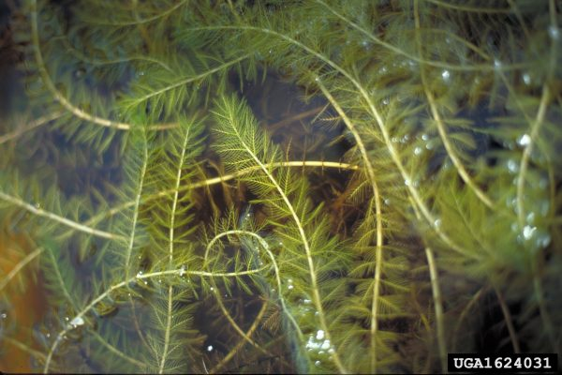
Eurasian Water Milfoil

Slide 20
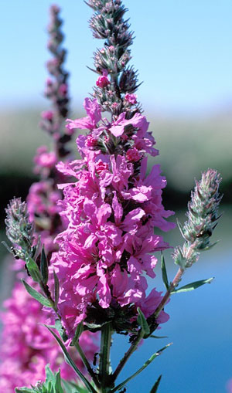
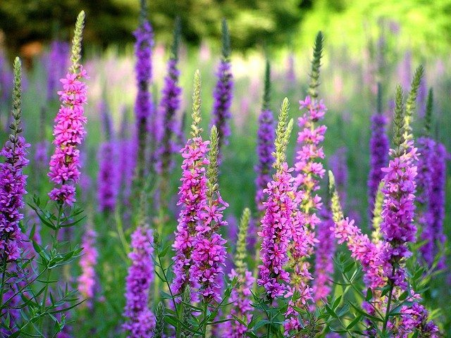
Purple Loosestrife

Slide 21
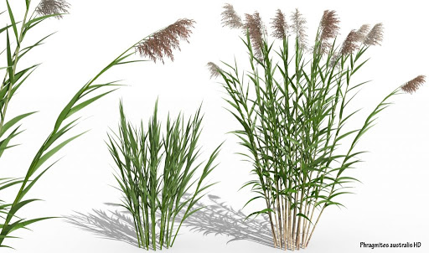
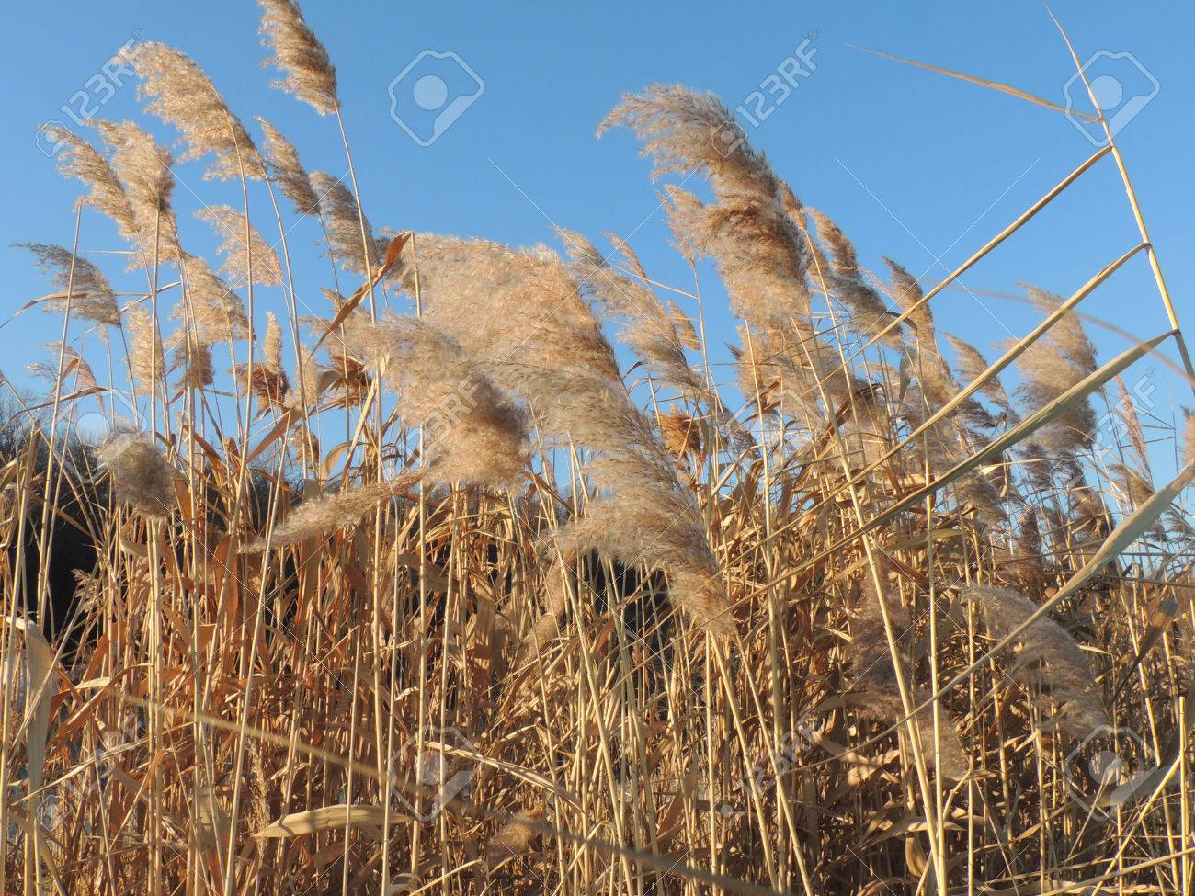
Phragmites

Slide 22
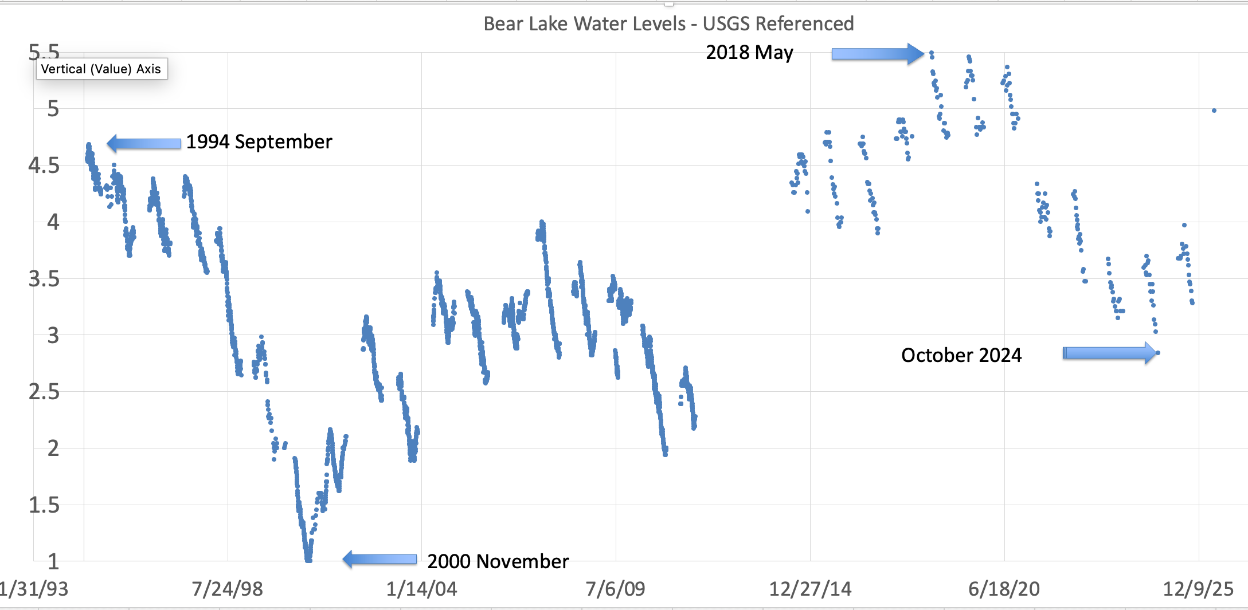
Lake Water Levels – Historical

Slide 23

Fish
Stockings
  Added April 20, 2026
    5,200 rainbow trout averaging 7.43”
    14,898 brown trout averaging 7.43”

Slide 24
Website Review
Tabs
Informational Videos
  Rake the Lake
  Septic System (coming soon)
  Loons (coming soon)

Slide 25
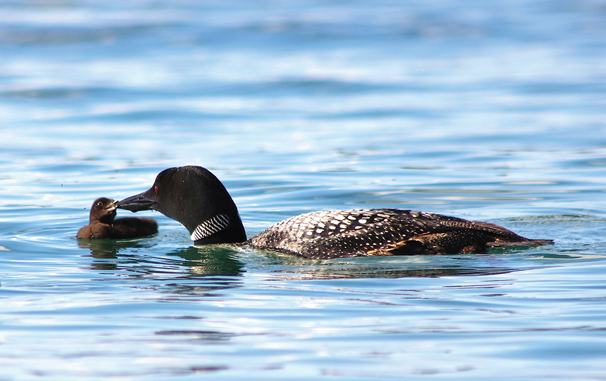
Loon Report – Mary, The Loon Ranger
From Bear Lake Photojournalist, Kim Schneider
https://www.mibluemag.com/postcard-1/loon-love/

Slide 26
Open Discussion

Slide 27
What You Can Do
Stay committed to a healthy lake
RAKE-THE-LAKE. Decomposing leaves produces muck.
Naturalize your shorelines
Clean boats & trailers before launching
Check your septic system & keep them functioning well
High speed/wake boating only from 11 am – 7:30 pm
Wave energy causes erosion and nutrient dump. We advise travel more than 500’ from end of docks/rafts.
Do not feed the ducks or geese
Protect our loons

Slide 28
Adjourn
Q & A: email bearlakekalkaska@gmail.com
Minutes, presentation, PLM & CLMP on website bearlakeassoc.com
Sign-up for automatic email notes

