Slide 1

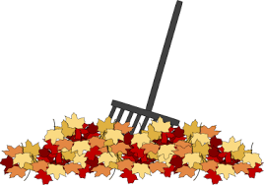
What can you do to help protect Bear Lake?
Do not rake leaves into the lake. Decomposing leaves produces more muck.
Do not feed the ducks and geese.
Remove dog, geese and duck droppings from lawns, docks, etc. Excess feces will increase nutrients within the lake.
If you do fertilize make sure you are using Phosphorus free fertilizer. One pound of phosphorous may produce over 775 pounds of algae-“The slimy green stuff”.
Perforate lawn periodically and seed and mulch exposed soil (to prevent erosion).
Remove aquatic plants, leaves/branches and other debris that washes up along the lakeshore so less decomposition occurs in or near the lake.
Always use silt fences when building a new home or doing any yard-work that would cause erosion.
Keep all burn piles and debris piles away from lake. Do not burn near the water. The ash is concentrated nutrients!
Encourage the use of stone, brick and similar porous materials when building a landscape to minimize urban water collection.
Create a natural buffer close to the water’s edge.
  A natural setting will filter excess nutrients from entering the water
  Decreases erosion.
  Deters geese from making a stop on your beach front. Geese do not like areas where they cannot see the predators coming towards them.

Slide 2

Natural Shoreline & Nutrient Abatement
Lakeshore residents should also be encouraged to manage their waterside landscapes according to the recommendations outlined in publications on this topic available from the MSU Extension.
Rooted plants derive most of their key nutrients from the sediments; thus, they respond slowly, if at all, to reductions in nutrient loading. In fact, if reductions in nutrient loading lead to improved water clarity, the growth of rooted plants will probably increase.
If organic material (muck) accumulates to undesirable levels in shoreline areas, bacterial treatments should be considered as a way to alleviate the buildup.
Shoreline development has led to habitat degradation and as lakes continue to become more and more developed, the impacts continue to be damaging to the lake ecosystem.
  From mowed grass and sandy beaches, to seawalls and riprap and fertilizer, development has negatively impacted a lake in all ecological aspects.
  Working to reduce the human footprint around the lake, the health of the lake will be improved.
  Natural shoreline restoration is helpful from reducing nutrient loading and runoff to providing habitat for frogs and fish to naturally defending against Canadian geese congregating in your yard, it is important that action is taken to minimize development impact and restore natural features.
  Maintaining a natural shoreline can greatly aid in the overall health of the lake.

Slide 3

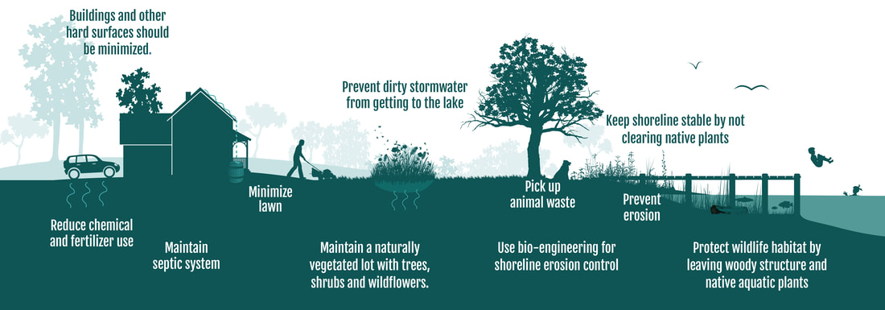
Converting seawall shorelines back to natural vegetation; plants, trees and shrubs along the water’s edge has many benefits for the lake.
  Benefits include erosion control, nutrient and pollution absorption, increase in wildlife and fish habitat and reduction of nuisance geese on lawns.
  If seawall removal is not feasible there are other options residents can do to improve and protect the lake.
  Placing rip rap in front of a seawall will help reduce wave action thus reducing lake scour. Rip rap can also create a suitable shoreline for animals to access the land and provide places for aquatic insects and plants to grow.
  Native vegetation can be planted within the rip rap, creating a more natural shoreline. Adding rip rap is an easy, affordable and effective way to help the lake.
Picture courtesy of MI Natural Shoreline Partnership

Slide 4

Prevention
Early detection and rapid response is key to a successful program.
Community education and outreach is key to preventing introductions.
More often than not, nonnative aquatic plants (exotic species) were possibly introduced by boats and/or boat trailers.
Preventing their inadvertent introduction to your lake can significantly lower the cost of future lake management.
Education can be an effective preventative measure.
  Newsletter articles should alert lake residents to the threat from exotic nuisance plants and animals.
  Warning signs should be erected at any public boat access sites, if applicable, that encourage boaters to clean boats and trailers when launching or removing watercraft from the lake.

Slide 5

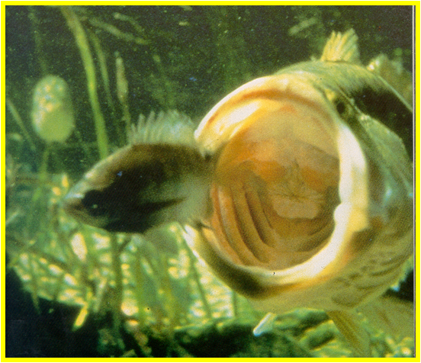
Goals of Aquatic Plant Management
Control Exotic Species
  Promote a Balanced and Diverse Native Plant Community
  Improve Fisheries
  Maintain Property and Recreational Values
Native Plant Species
  Fundamental component of aquatic ecosystems
  Perform important functions
  Stabilizing sediments
  Support aquatic insects
  Maintaining Oxygen
  Provide forage and refuge areas for fish

Slide 6

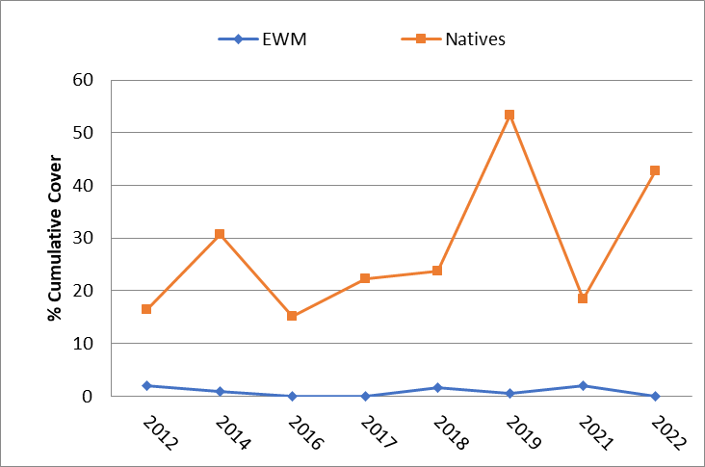
Native Plant Cover vs EWM Cover
PLM has been tracking plant trends in Bear Lake as part of the management program. Per request an AVAS was not performed in 2023. Our most recent AVAS survey in 2022, the cumulative cover was found and plant diversity was good with 14 native plant species identified, with good overall coverage. Additional monitoring will allow plant health to be determined long term. PLM recommends doing an AVAS survey again in 2024. Graph 1 shows the cumulative coverage of native and nonnative plants. The 2022 treatment was effective and no EWM was found in the end of year survey. Additional monitoring in the future will allow plant trends and overall health of plant community be determined.

Slide 7
Bear Lake Native Plant Diversity Over Time
PLM has been tracking native plant diversity in Bear Lake as part of the management program. Our most recent AVAS survey in 2022, the total number of species is very consistent, and has improved since the beginning of the program.

